Slide 1


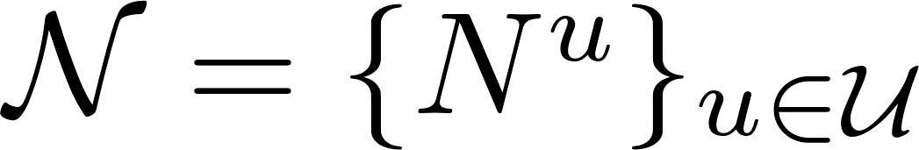
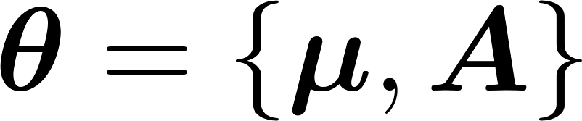
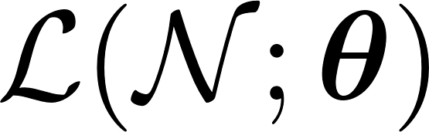
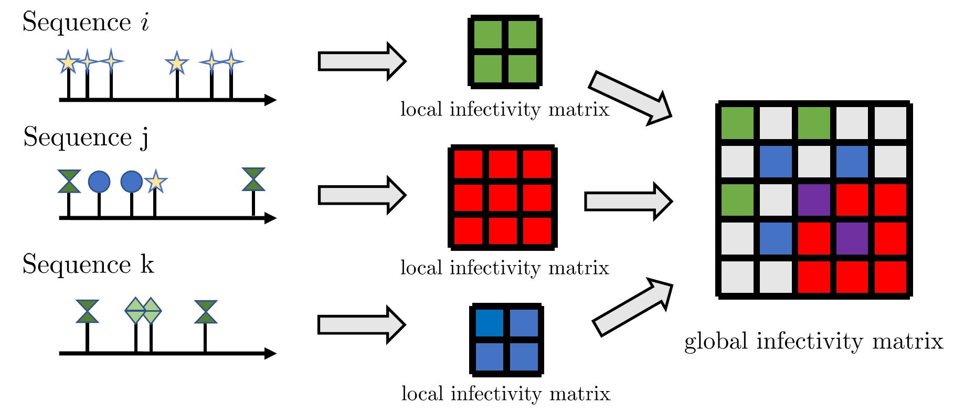
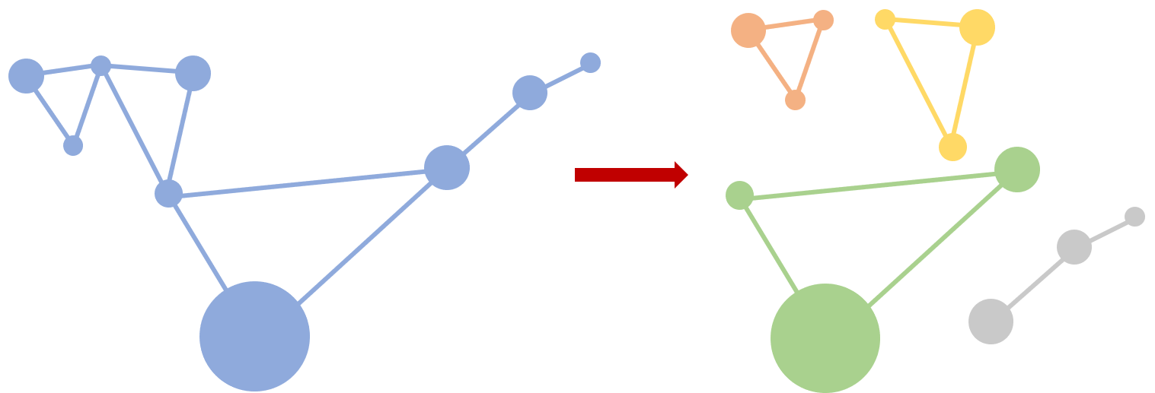
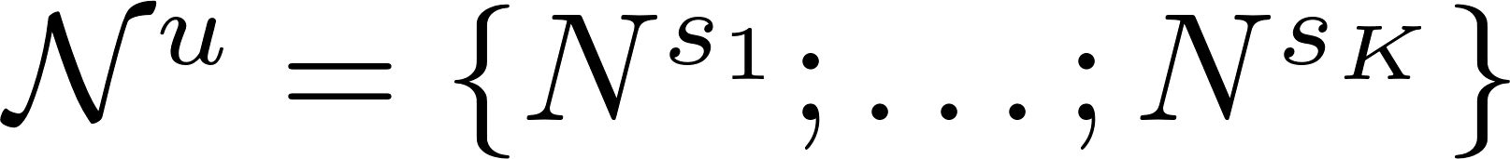
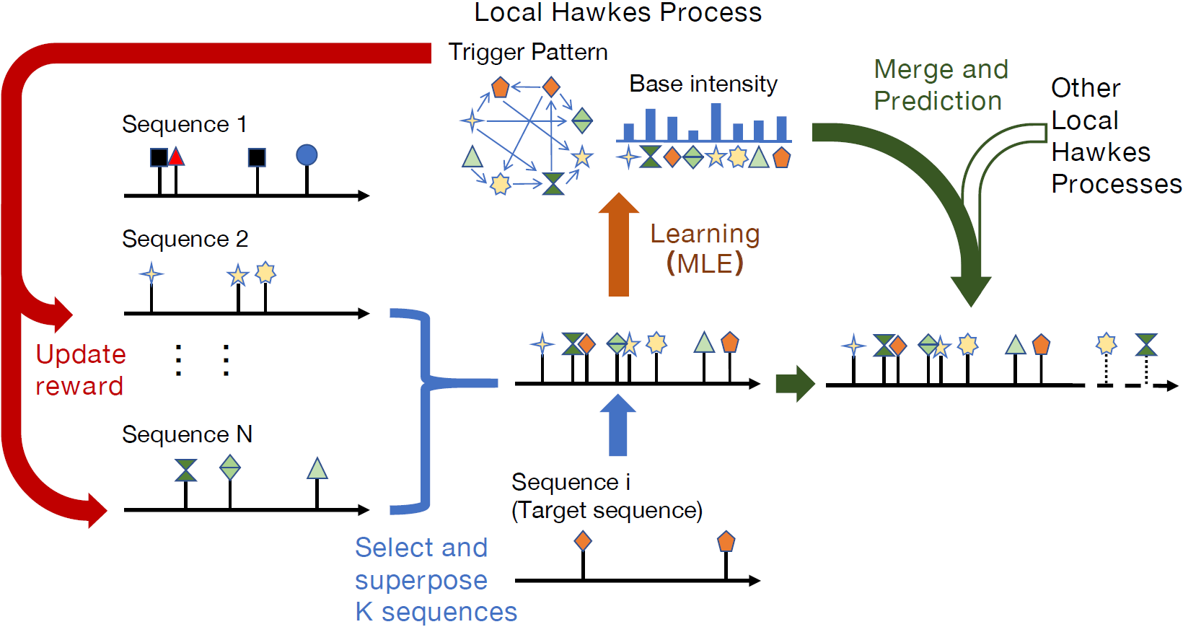
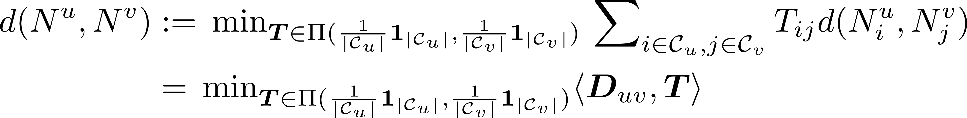
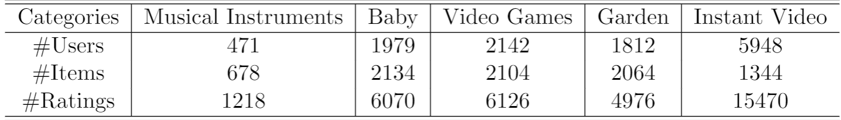
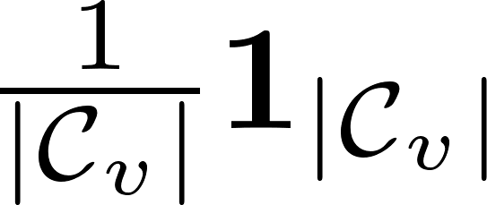

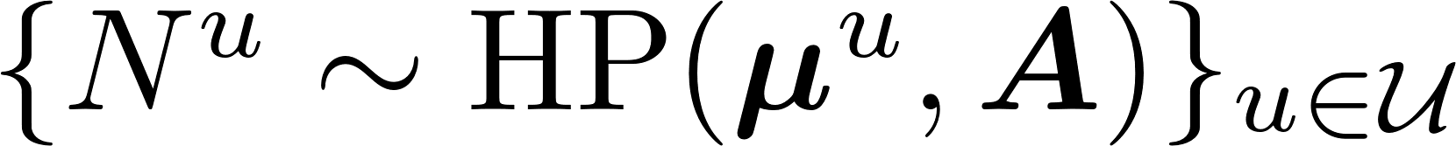
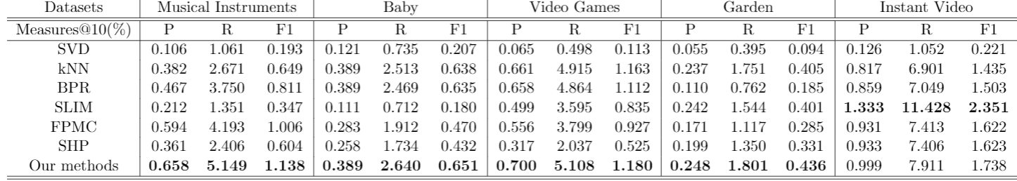
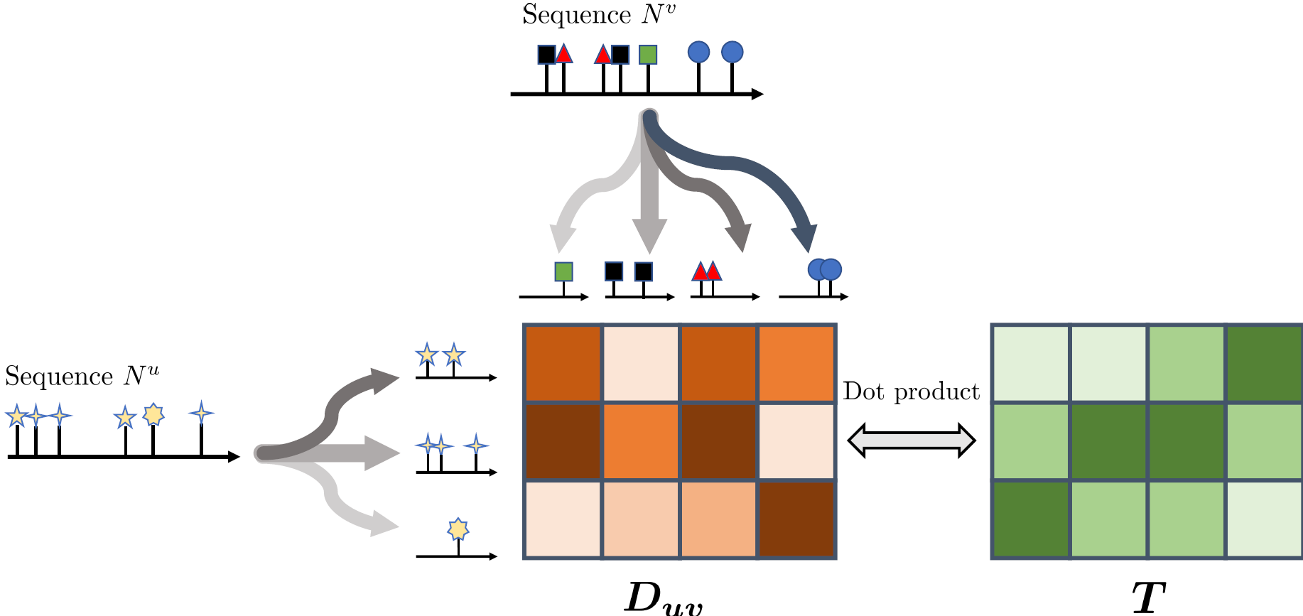
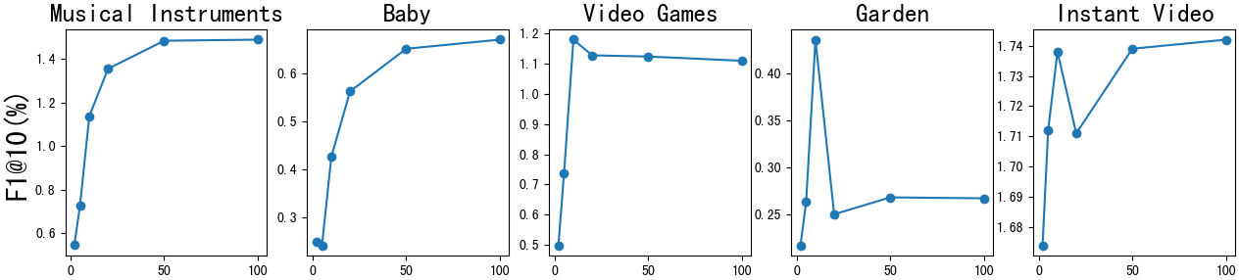
Self-Organized Hawkes Processes
Shen Yuan^{1,2,3} and Hongteng Xu^{1,2,*}
¹Gaoling School of Artificial Intelligence, Renmin University of China
²Beijing Key Laboratory of Big Data Management and Analysis Methods
³University of Electronic Science and Technology of China
*Email: hongtengxu@ruc.edu.cn
^{Introduction}
^{Objective function}
Merging learned Hawkes processes
The real-world applications of Hawkes processes often suffer from the following limitations:
By the maximum likelihood estimation, we can learn the Hawkes process:
In the inference phase, instead of leveraging the intensity function of each local Hawkes process to make predictions, we first merge the learned infectivity matrices by superposition operations.
Complicated mutual-triggering pattern of the different event types within each real-world sequence;
Then, for each sequence, we predict its future events based on its local base intensity and the global infectivity matrix.
Huge number of event types and extremely few historical observations.
Where,
This paper is motivated by a fact that the complex global interrelation between events tend to consist of simple local structures.
is a set of event sequences;
The local base intensity reveals the preference of the user on purchased items while using the global infectivity matrix helps the system to explore the items that she never saw but might be interested in.
represents the model parameter;
We proposed the self-organized Hawkes process(SOHP) model that learns heterogeneous local Hawkes processes based on subsets of observed event sequences.
is the likelihood function of the event sequences.
We proposed a method that apply SOHP model into sequential recommendation system, which achieves higher f1 scores than state-of-the-art methods.
After introducing a new self-organization mechanism, the objective function becomes:
Where represents the K neighbors of the u-th sequence.
Figure 1: An illustration between the complex global interrelation and the simple local structures.
Figure 2: An illustration of merging local infectivity matrices.
^{Initial Benefit}
^{Experiments}
We define the initial benefit based on the optimal transport distance between event sequences.
We conduct our experiments on the Amazon dataset. This dataset contains product reviews from Amazon spanning May 1996 - July 2014.
Superposition of Hawkes processes
Table 1:Statistics of our datasets.
Where,
We are motivated by a fact that the complex global interrelation between events tend to consist of simple local structures.
Table 2 summarizes the performance for the baselines and our method on the five datasets.
represents the set of joint distributions with marginals and
Meanwhile, there exists the superposition property of Hawkes process:
Specifically, in the category ``Musical instrument'', the result of our model is 13% higher than that of the best baseline, and the difference would be up to 48% by tuning K in the subsequent experiments.
is a distance matrix, where represents the discrepancy between the sequence of the type-i events and that of the type-j events.
For a set of independent Hawkes processes with a shared infectivity matrix ,the superposition of their sequences satisfies .
Thus, we can superpose different Hawkes processes to learn the target Hawkes process.
The results indicate the effectiveness of our model for sequential recommendation.
Fig.3 illustrates the optimal transport distance. The optimal transport distance can be calculated efficiently by the Sinkhorn scaling algorithm.
However, when learning multiple heterogeneous Hawkes processes in a complicated scenario, the event sequences belong to different Hawkes processes that have various infectivity matrices.
Table 2:Summary of the performance for baselines and our model.
In such a situation, superposing the event sequences randomly is likely to disobey the assumption imposed in the superposition property of Hawkes process.
In addition, we study the performance of our model on F1@10 by tuning K in the range of {2,5,10,20,50,100}. Results are shown in Fig.4.
To overcome this problem, we design a new self-organization mechanism, selecting event sequences for each local Hawkes process and adjusting the selection with the training progress.
For each target sequence, we treat the selection of its neighbors (the training set of a Hawkes process) as a multi-armed bandit problem, selecting their neighbors according to the potential rewards.
Figure 3:The optimal transport distance between heterogeneous event sequences.
Figure 4:Performance of our model under different number of neighbors K.

